Slide 1
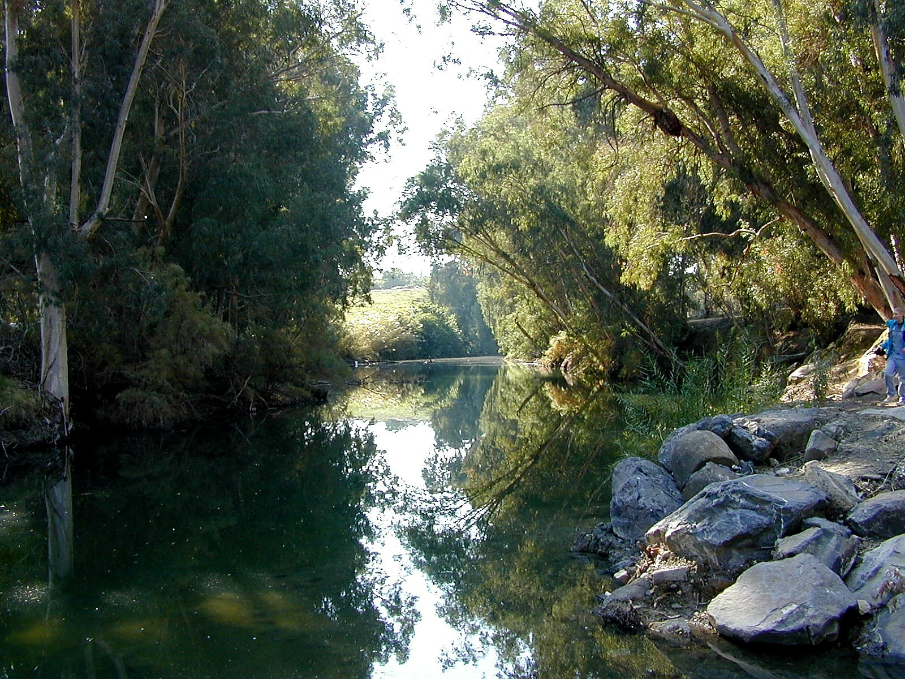
The Jordan River
Photograph ©2006 by Todd Bolen / bibleplaces.com

Slide 2
John 1.1:
In the beginning was the Word,
and the Word was with God,
and the Word was fully God.
The Word is eternal.
The Word is not God the Father.
The Word is divine like God.
John 1.2: The Word was with God in the beginning.

Slide 3
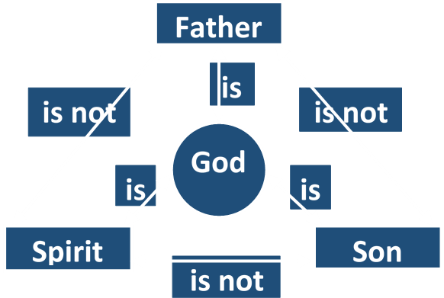

Slide 4
John 1.1-2: In the beginning was the Word, and the Word was with God, and the Word was fully God. The Word was with God in the beginning.
v.14: became flesh
v.17: is Jesus Christ

Slide 5
John 1.3: All things were created by him, and apart from him not one thing was created that has been created.

Slide 6
John 1.4-5: In him was life, and the life was the light of mankind. And the light shines on in the darkness, but the darkness has not mastered it.

Slide 7
John 1.4-5: In him was life, and the life was the light of mankind. And the light shines on in the darkness, but the darkness has not mastered it.
καταλαμβάνω = overcome
[win, seize, grasp]

Slide 8
John 1.6-8: A man came, sent from God, whose name was John. He came as a witness to testify about the light, so that everyone might believe through him. He himself was not the light, but he came to testify about the light.

Slide 9
John 1.9-11: The true light, who gives light to everyone, was coming into the world. He was in the world, and the world was created by him, but the world did not recognize him. He came to what was his own, but his own people did not receive him.

Slide 10
John 1.9-11: The true light, who gives light to everyone, was coming into the world. He was in the world, and the world was created by him, but the world did not recognize him. He came to what was his own, but his own people did not receive him.
γινώσκω = know, comprehend, perceive, recognize

Slide 11
John 1.12-13: But to all who have received him– those who believe in his name– he has given the right to become God's children – children not born by human parents or by human desire or a husband's decision, but by God.

Slide 12
John 1.14: Now the Word became flesh and took up residence among us. We saw his glory– the glory of the one and only, full of grace and truth, who came from the Father.

Slide 13
John 1.14: Now the Word became flesh and took up residence among us. We saw his glory– the glory of the one and only, full of grace and truth, who came from the Father.
 Jesus is fully divine [the Son of God].
 Jesus is fully human.
 Jesus thus has two natures,
but they do not mix or conflict.

Slide 14
John 1.14: Now the Word became flesh and took up residence among us. We saw his glory– the glory of the one and only, full of grace and truth, who came from the Father.
μονογενής = one and only

Slide 15
John 1.15-17: John testified about him and shouted out, “This one was the one about whom I said, ‘He who comes after me is greater than I am, because he existed before me.’” For we have all received from his fullness one gracious gift after another. For the law was given through Moses, but grace and truth came about through Jesus Christ.

Slide 16
John 1.16-17: For we have all received from his fullness one gracious gift after another. For the law was given through Moses, but grace and truth came about through Jesus Christ.
Christ = Messiah = God’s Anointed One.
the savior, greatest prophet, high priest, and chosen king, whom God had promised would come.

Slide 17
John 1.16-17: For we have all received from his fullness one gracious gift after another. For the law was given through Moses, but grace and truth came about through Jesus Christ.

Slide 18
John 1.18: No one has ever seen God. The only one, himself God, who is in closest fellowship with the Father, has made God known.
Jesus is unique, divine, the light who reveals God and his salvation.
Jesus revealed…
 God in a way we could understand;
 how to live as a person created and transformed into God’s image;
 how to know God intimately and thus be saved.

Slide 19
Son of God [1-2, 14, 18]
Full revelation of God [1, 18]
Eternal Creator [1-3, 10-11]
Promised Messiah/Christ [11, 17]
Savior [12-13, 16-17]
Light that is Life [4-5, 9]
Who is Jesus?

